Slide 1
Weekly Report
Presenter: Sheng-Hsing Hsiao
Advisor: Jyh-Shing Roger Jang
Dept. of CSIE, National Taiwan University, Taiwan

Slide 2
Outline
Add functions to Demo page
Transfer Learning on MobileNet
Tensorflow.js
Demo

Slide 3
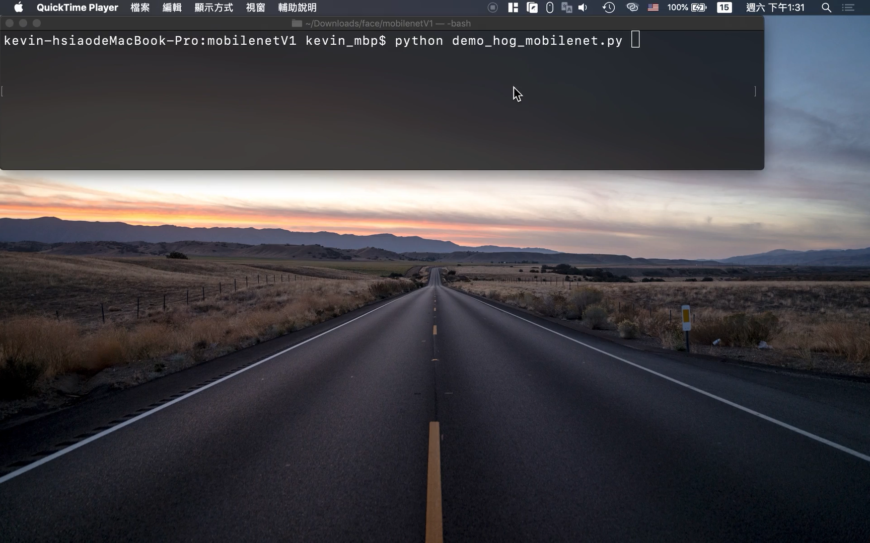
Transfer Learning on MobileNet
Hog Detection + MobileNet V1

Slide 4
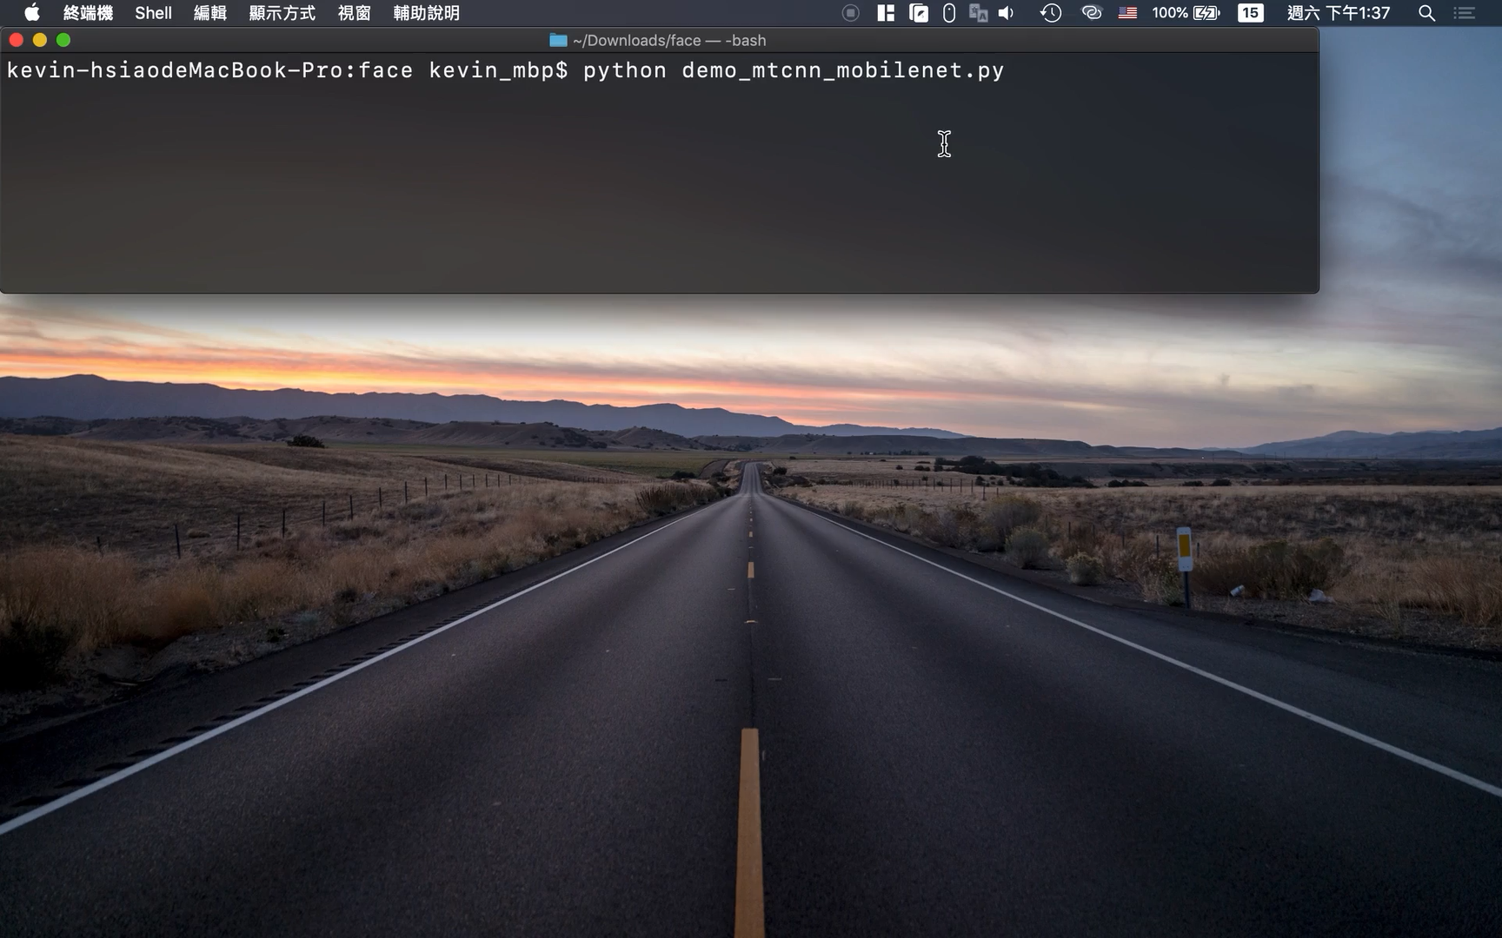
Transfer Learning on MobileNet
MTCNN Detection + MobileNet V1

Slide 5
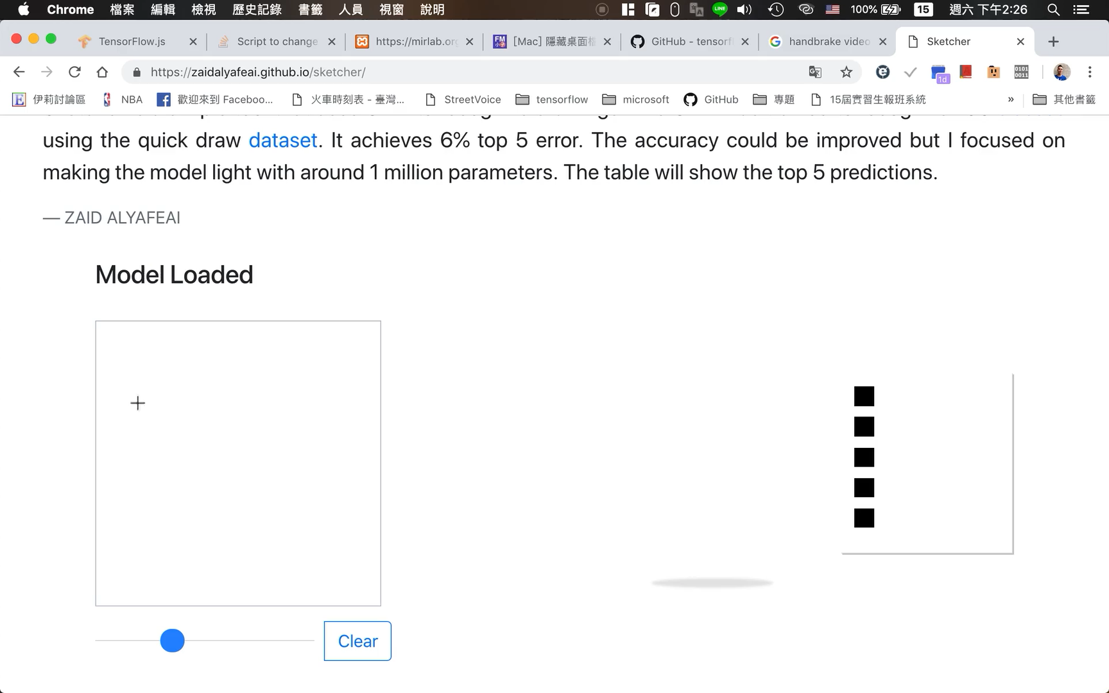
Tensorflow.js

Slide 6
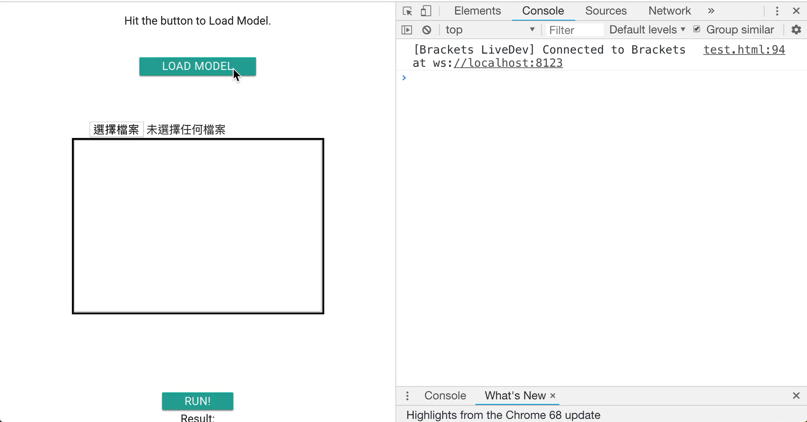
Tensorflow.js

Slide 7
Related Work
Reference
Tensorflow.js
zaidalyafeai.github.io
Tfjs-converter

Slide 8
Thank you for your attention

